Slide 1

Motion Control：Lecture 5.5
High Speed Small Lines Interpolation
Jiangang Li
14 Nov 2016

Slide 2


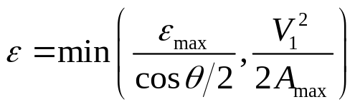






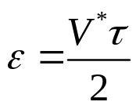



From Fig3.6(a), :
C
θ
(3-1)
A
B
(a) Tool path
Where, is given.
Block A
Block B
From Fig3.6(c):
t
(3-2)
(b) Velocity plan
(3-3)
(c) Blended area
Fig 3.6 Velocity and corner error

Slide 3
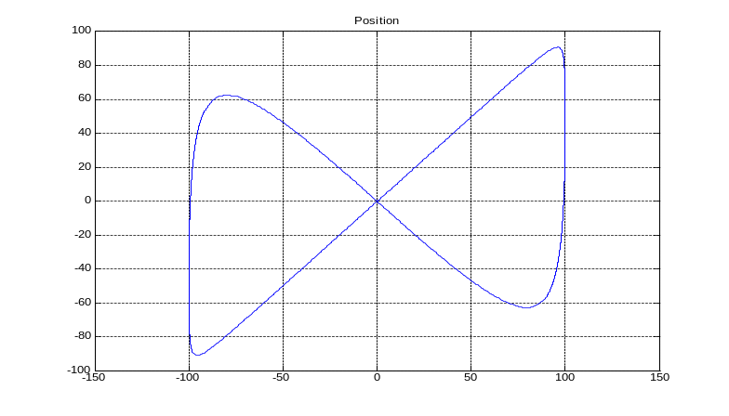
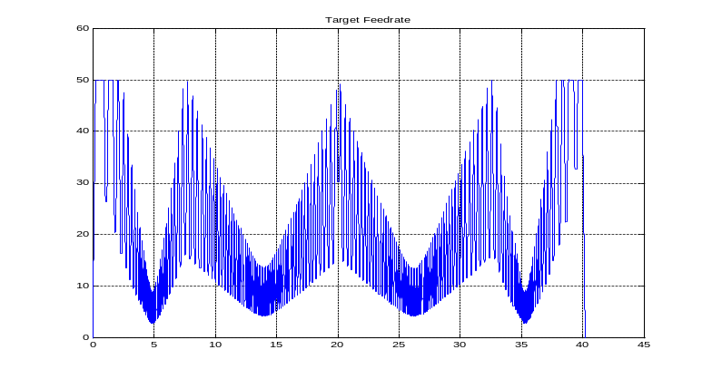
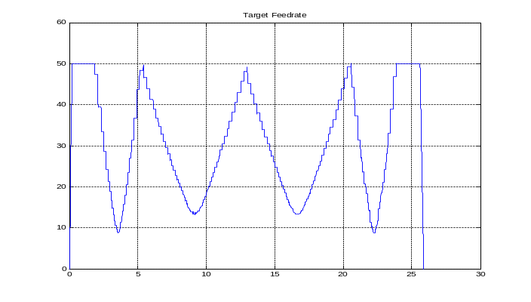


Fig 3.11 Continuous tool path for simulation
Fig 3.12 Velocity plan with
machining time is about 40s
Fig 3.13 Velocity plan with
machining time is about 25s

Slide 4
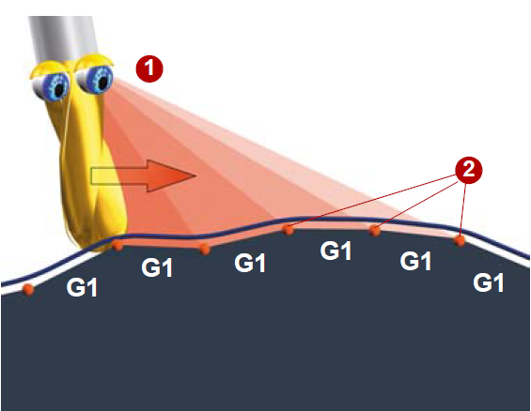
Look ahead - anticipatory velocity control:
The control calculates several NC blocks in advance and determines a modal velocity profile.

Slide 5
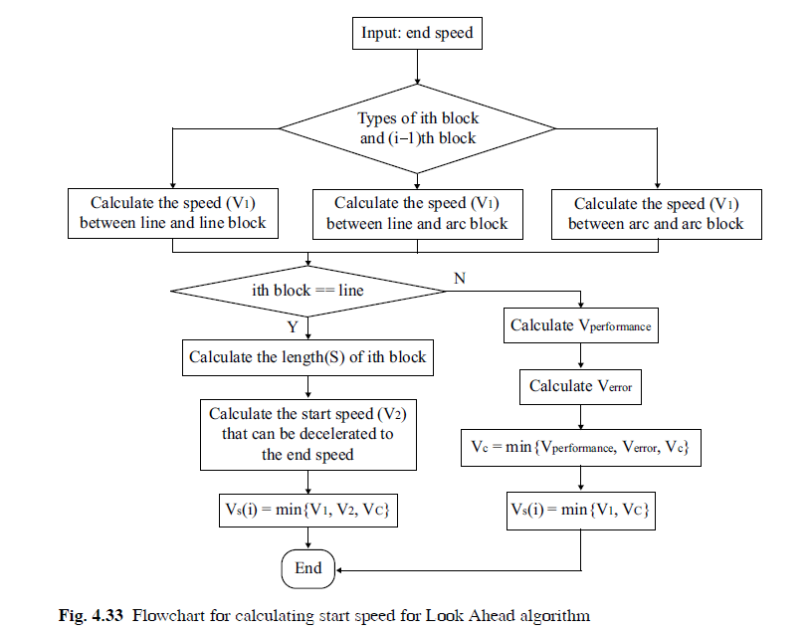
2 New Method

